Slide 1
Data Analysis & Visualization
Energy Consumption

Slide 2
Table of contents
01
02
03
04
Exploratory Data Analysis
Outlier Detection and Handling
Unveiling Insights through Data Cleaning and Manipulation
IQR Method and treatments for handling.
Analysis with Excel & Mysql
Analysis & Dashboard with Power BI
Unlocking Insights: Data Analysis and Trend Analyis, what if Anlysis
Interactive Power BI Dashboard for actionable insights.

Slide 3
Preface:
In the Energy Consumption data total 3 countries data were analyzed that includes India, Indonesia and Iceland
The Electricity Consumption, Energy Demand and GDP are directly proportional to each other
The India has the Highest Energy Consumption and where as Iceland has the least Energy Consumption

Slide 4
Environment Setup
There are various approaches for setting up an environment for Data Analysis and Data Visualization. Some of them are:
Approach | Purpose
Google colab | Exploratory Data Analysis (EDA)
MySql | Advance Analysis, Exploratory Data Analysis (EDA)
Ms Excel | Data Analysis & Visualisation
Power BI | Data Visualisation
Among these, we have chosen VS code for E.D.A , Excel for Data Analysis and PowerBI for Data Visualisation.

Slide 5
01
Exploratory Data Analysis
Data preprocessing

Slide 6

Data Cleaning and Data Manipulation
Imported are some of the packages like pandas, numpy, matplotlib and seaborn for data analysis and data manipulation
Pandas for Data Analysis
Numpy for Numerical Operations
Matplotlib and Seaborn for Data Visualisation.
Read the CSV file into a DataFrame, replace 'your_file.csv' with the path to your CSV file.

Slide 7
It is to be known that this dataset has 300 rows × 128 columns as determined by using df.shape
Checked for the Duplicate values, but none were found.
Utilised df.describe() to get the Statistical Summary.
Replaced NAN into empty( blank space)df = df.fillna(‘’)
Checked for the Missing values, missing_values = df.isnull().sum()
Missing Values % were calculated by using null_percentage = df.isnull().sum() / len(df) * 100
Converted data type from objective to int by using df = df.apply(pd.to_numeric, errors='coerce’)
To fill the null values, the median for each column was find out by using median_values = df.median(), print("Median values for each column:")
print(median_values)
Filled that median columns into the dataset by using df.fillna(median_values,inplace=True)

Slide 8
Exported that data set to excel by using excel_file_path = 'output.xlsx’, df.to_excel(excel_file_path,index=False), print("Dataset copied to Excel sucessfully")
The same process repeated for all 3 data sets
I called all 3 data sets into 1 and compiled to merged one
Outliers were detected and along with sum of outliers for each column by using outliers_count = outliers.sum(), print("Number of outliers in each column:")
print(outliers_count)
As there are not much outliers were found in the dataset
I had selected the Primary Energy Consumption to remove the Outliers

Slide 9
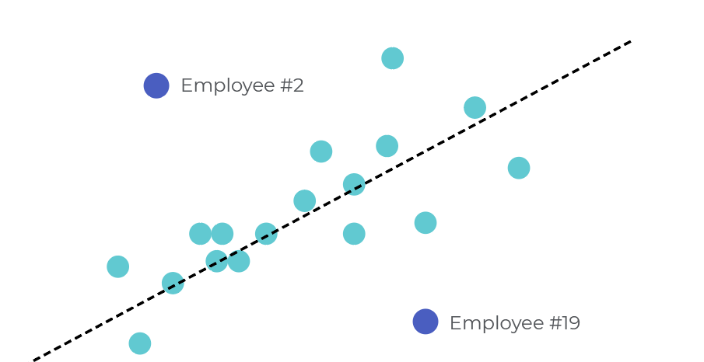
02
Outlier Detection & Handling
On the column ‘quantity’.

Slide 10
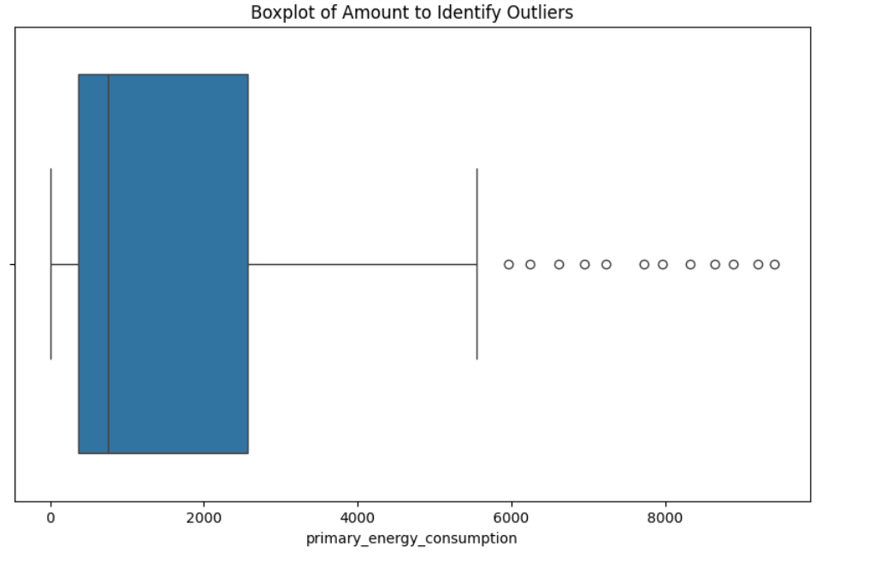
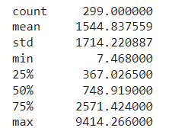
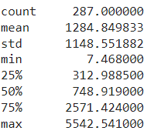
Outlier Detection
Box-plot is used to visually detect the outliers.
Getting the outliers using IQR method where quantile of Q1 is set to 0.25 and Q3 is set to 0.75.
Total no. of outliers: 12
Percentage of data loss: 1.05%
Before removing outliers:
After removing outliers:

Slide 11
Treatments to handle outliers
Trimming
Capping
Remove the outliers completely.
Replace the outliers with Upper value.
Transform (log)
Winsorization
Replace the outliers with log of itself.
Replace the outliers closer to the central part.

Slide 12
Statistics on Treatments
Method/Stats | Original | Trimming | Capping | Transforming | Winsorization
Records | 299 | 259 | 287 | 287 | 287
Mean | 1544.83 | 1206.87 | 1221.48 | 6.323 | 15.623
Std | 1714.22 | 967.27 | 1010.95 | 1.738 | 1.779
Max | 9414.26 | 2742.25 | 2700.50 | 8.620 | 15.624

Slide 13
GeoSpatial Analysis
Install and import Geopandas Library.
'Naturalearth_lowres' is map dataset which is built-in dataset provided by GeoPandas.
The map dataset is read and GeoDataFrame is formed which is then compared with the our DataFrame to plot map.

Slide 14
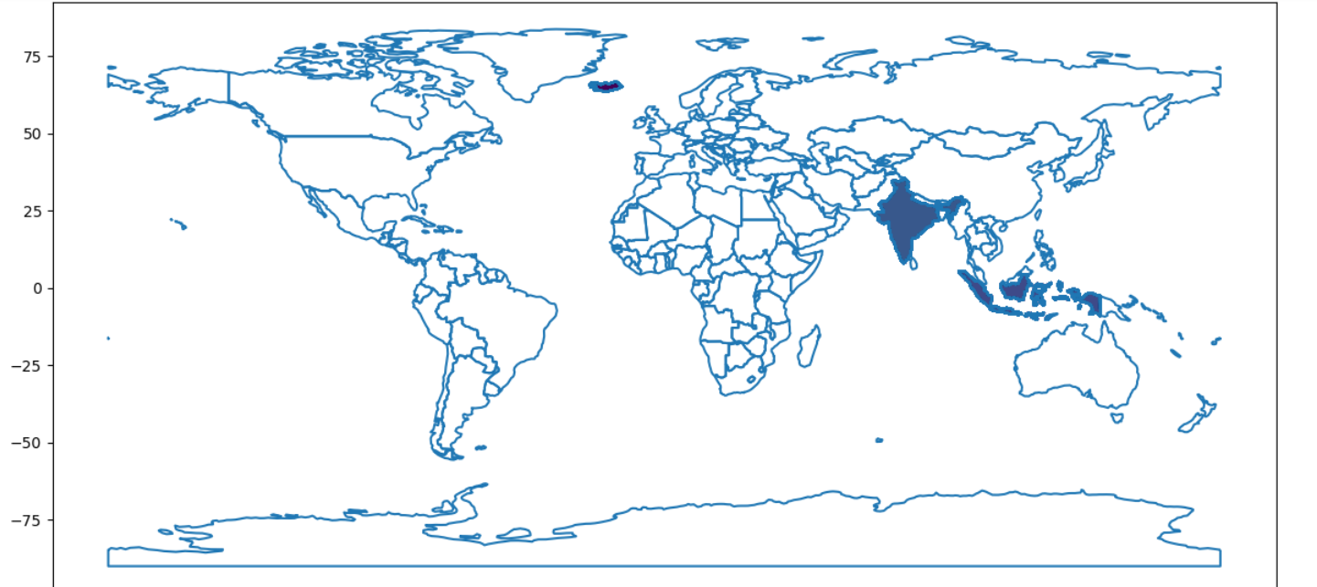
GeoSpatial Analysis

Slide 15
03
Analysis with Excel & MySql

Slide 16
Relationship between Energy Consumption v/s Electricity Demand
The above chart shows the Electricity demand and Energy Consumption in percentage by country wise
Where as India is in top place for the consumption and demand and both are directly proportional to each other

Slide 17
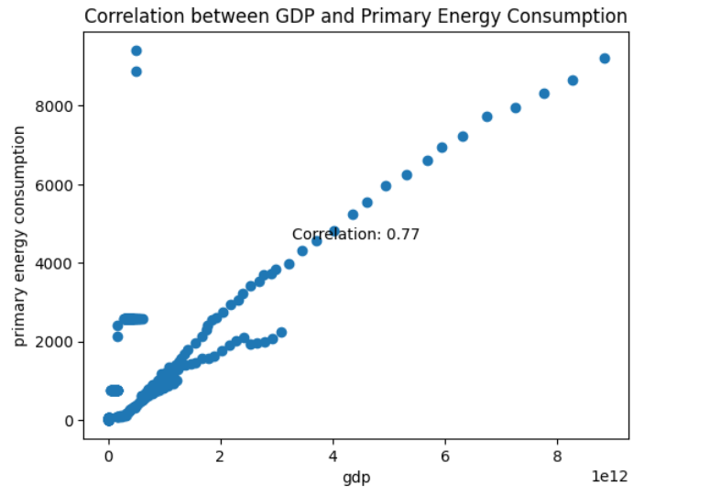
Correlation between GDP and Primary Energy Consumption
The graph shows a Positive Correlation between the GDP and Primary Energy Consumption

Slide 18
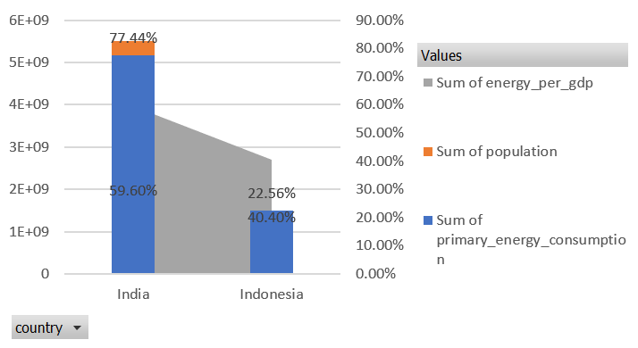
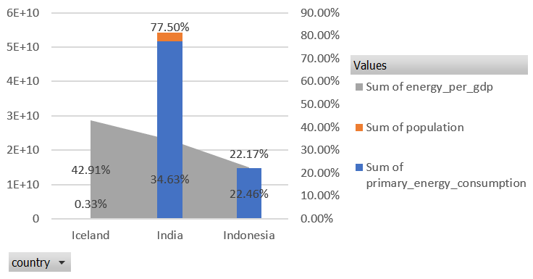
Trend Analysis: Quaterwise
Quarter 2
Quarter 1
The population count by country wise along with the primary energy consumption(all sources such as fossil fuels(coal,oil,natural gas), nuclear energy & renewable sources(solar, wind) and energy per gdp were taken to analyze the Energy Intensity that gives the insights into the energy efficiency and economic productivity of a country
In the Quarter 1 & 2 – Indonesia producing more economic output with less energy consumption and India is using more energy to produce the same amount of economic output

Slide 19
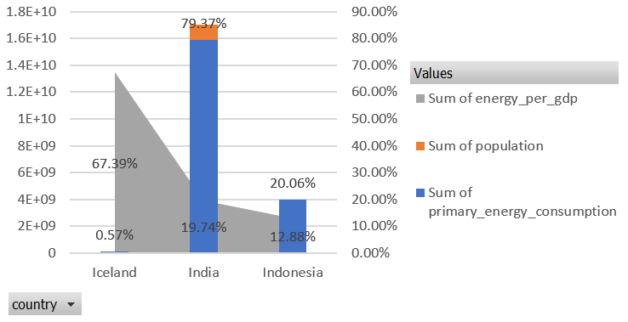
Trend Analysis: Quaterwise
Quarter 3
In the Quarter 3 – Iceland producing more economic output with less energy consumption and India is using more energy to produce the same amount of economic output
India has a lower energy per GDP ratio compared to Indonesia and Iceland, indicating that India is more energy efficient , producing more economic output per unit of energy consumed

Slide 20
04
Analysis & Dashboard with Power BI

Slide 21
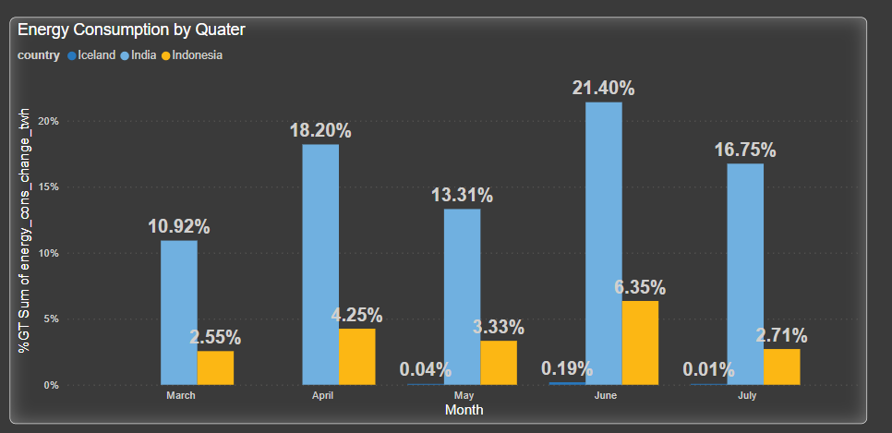
Energy Consumption - Month Type:
The Clustered Column chart illustrates the quantity of imports by month.
The Dataset contains the Energy Consumption between from March to July
In the month of June, the Energy Consumption % was more by the country India that is 21.40% and whereas the Iceland with 0.04% in the month of may

Slide 22
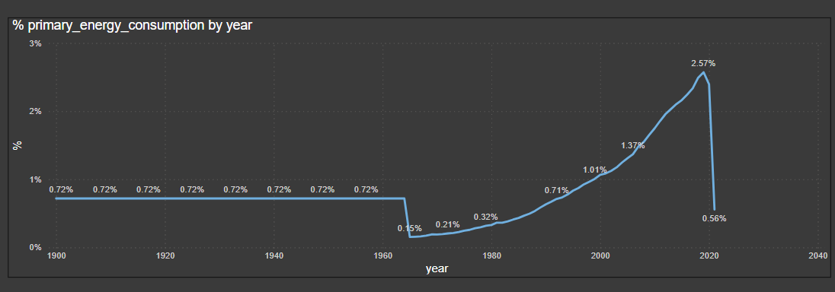
Primary Energy Consumption by Year wise
The Line chart illustrates the year wise primary energy consumption by % , Providing a visual comparisons of their respective imports volumes.
In the year 2019, has highest energy consumption with 2.57% whereas in the year 1965 has least energy consumption of 0.15%

Slide 23
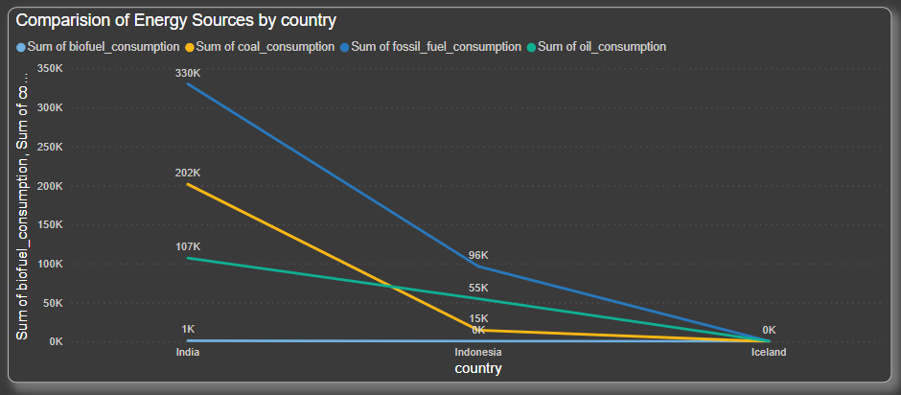
Comparision of Energy Sources Consumption by Country:
India has the highest biofueal, coal, fossil, oil consumpution where as Icland has the least consumption

Slide 24
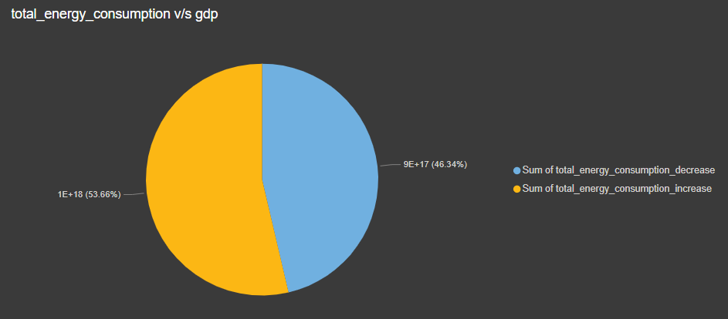
Whatif Analysis – Primary Energy Consumption by GDP
By using what if analysis in the MySql, the % of primary energy consumption with the increase of 10% gdp and with decrease of 5% gdp, the energy consumption were calculated and that data exported to Power Bi for the visualization
The sql query as below mentioned
Increase GDP by 10% SELECT primary_energy_consumption * (gdp * 1.1) AS total_energy_consumption_increase from final_energyyyyyyyy;
#Decrease GDP by 5%SELECT primary_energy_consumption * (gdp * 0.95) AS total_energy_consumption_decrease from final_energyyyyyyyy;
On the baseline of primary energy consumption, if the gdp decreases 5%, it will decreases upto 43% , where as if increase to 10%, then increase to 53%

Slide 25
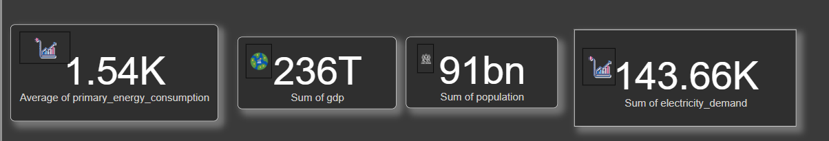
KPI’s :
Created a dynamic Power BI dashboard and reports to visualize key performance indicators (KPIs).
Created four KPIs. – Average of Primary Energy Consumption, Sum of GDP, Total Count of Population and Total Electricity demand over 3 countries India, Indonesia and Iceland

Slide 26
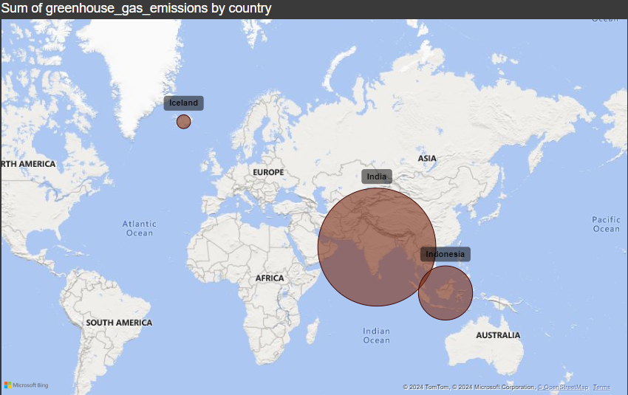
Greenhouse Emission by Country:
Used Power BI charting tools to create a map visualization.
In this map visualization plots on the ‘Greenhouse emission by Country’
Here the Pink bubble shows the area of highest consumption

Slide 27
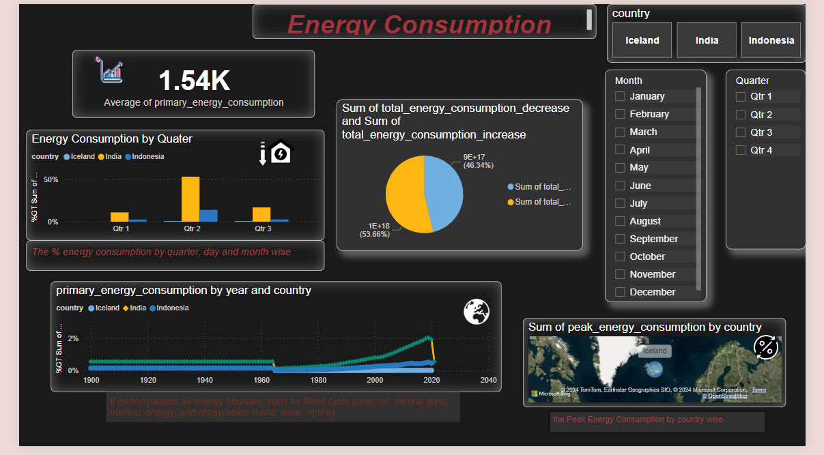
FINAL DASHBOARD OF POWER BI: Energy Consumption

Slide 28
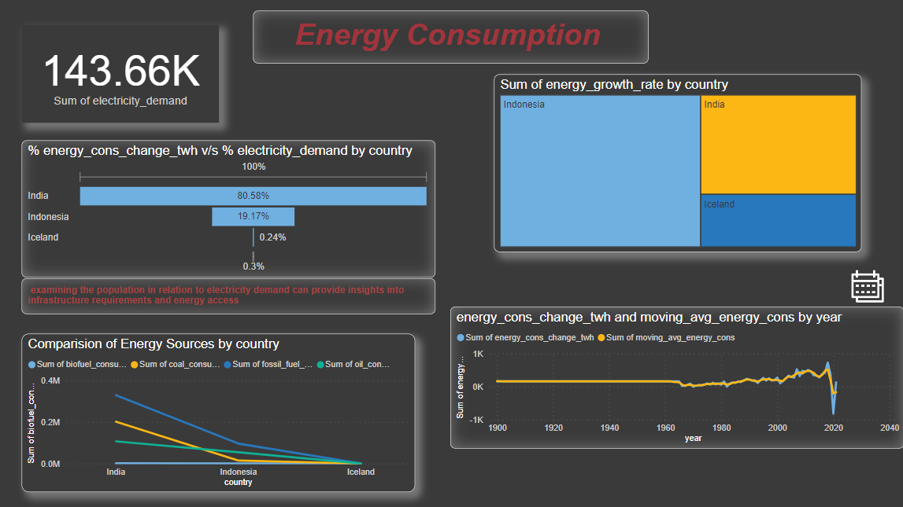
FINAL DASHBOARD OF POWER BI: Energy Sources

Slide 29
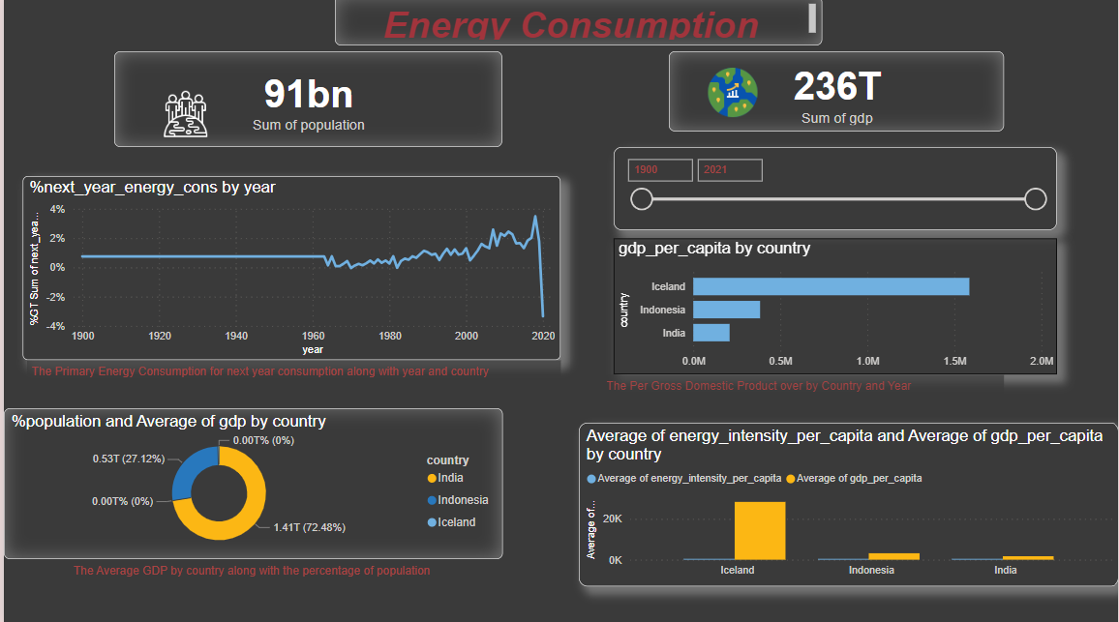
FINAL DASHBOARD OF POWER BI: GDP & COUNTRY

Slide 30
Reference
https://colab.research.google.com/drive/1xlYRPSKI1KtiJQcGqkZnLcWAIyhpSDbF?usp=sharing
https://colab.research.google.com/drive/10DZni0kld_fyKPKVmgVykNvCqnbQwxX9?usp=sharing
https://colab.research.google.com/drive/1jjfMwAwx-SNSmETWb4ijPUCmjHFdGSR2?usp=sharing
https://colab.research.google.com/drive/1jjfMwAwx-SNSmETWb4ijPUCmjHFdGSR2?usp=sharing

Slide 31
Thank
You!

